Slide 1
20180723
Lab meeting
Lee Jong Geon

Slide 2
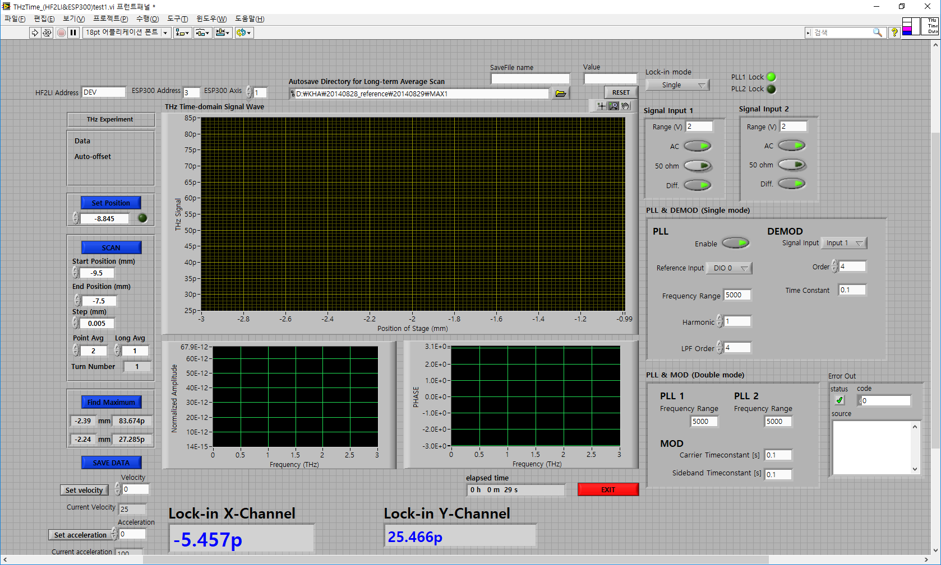
Double Lock-in
Phase Lock
Indicator

Slide 3
Double Lock-in
NSOM test
SR830 (Single)
HF2LI (Double)+Chopper(pump)

Slide 4
Double Lock-in
NSOM test
SR830 (Single)+Chopper(pump)
HF2LI (Double)+Chopper(pump)

